Slide 1

UNIVERSITY INSTITUTEOF ENGINEERING
Bachelor of Engineering (Computer Science & Engineering)
Operating System (20CST/ITT-313)
Subject Coordinator: Er. Puneet Kaur(E6913)
Introduction to Operating System
DISCOVER . LEARN . EMPOWER
Font size 24

Slide 2
Distributed and Network Operating Systems
.

Slide 3
Introduction
Distributed system is collection of loosely coupled processors interconnected by a communications network
Processors variously called nodes, computers, machines, hosts
Site is location of the processor
Reasons for distributed systems
Resource sharing
sharing and printing files at remote sites
processing information in a distributed database
using remote specialized hardware devices
Computation speedup – load sharing
Reliability – detect and recover from site failure, function transfer, reintegrate failed site
Communication – message passing

Slide 4
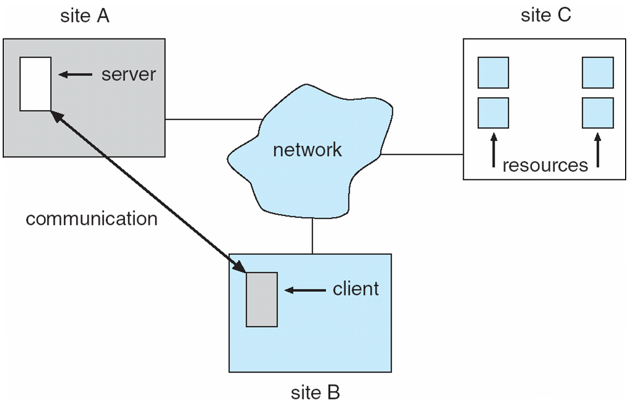
A Distributed System

Slide 5
Types of Distributed Operating Systems
Network Operating Systems
Distributed Operating Systems

Slide 6
Network-Operating Systems
Users are aware of multiplicity of machines. Access to resources of various machines is done explicitly by:
Remote logging into the appropriate remote machine (telnet, ssh)
Remote Desktop (Microsoft Windows)
Transferring data from remote machines to local machines, via the File Transfer Protocol (FTP) mechanism

Slide 7
Distributed-Operating Systems
Users not aware of multiplicity of machines
Access to remote resources similar to access to local resources
Data Migration – transfer data by transferring entire file, or transferring only those portions of the file necessary for the immediate task
Computation Migration – transfer the computation, rather than the data, across the system

Slide 8
Distributed-Operating Systems (Cont.)
Process Migration – execute an entire process, or parts of it, at different sites
Load balancing – distribute processes across network to even the workload
Computation speedup – subprocesses can run concurrently on different sites
Hardware preference – process execution may require specialized processor
Software preference – required software may be available at only a particular site
Data access – run process remotely, rather than transfer all data locally

Slide 9
Network Structure
Local-Area Network (LAN) – designed to cover small geographical area.
Multiaccess bus, ring, or star network
Speed ≈ 10 – 100 megabits/second
Broadcast is fast and cheap
Nodes:
usually workstations and/or personal computers
a few (usually one or two) mainframes

Slide 10
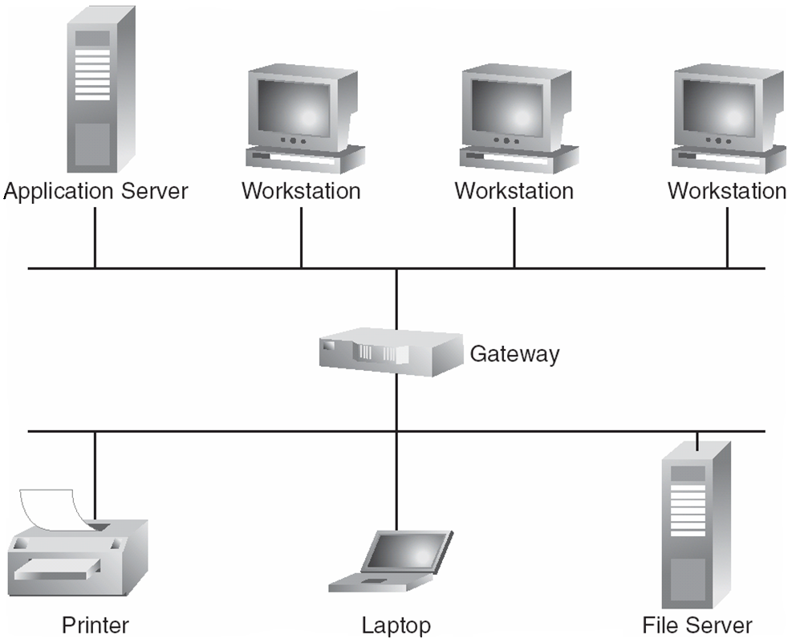
Depiction of typical LAN

Slide 11
Network Types (Cont.)
Wide-Area Network (WAN) – links geographically separated sites
Point-to-point connections over long-haul lines (often leased from a phone company)
Speed ≈ 1.544 – 45 megbits/second
Broadcast usually requires multiple messages
Nodes:
usually a high percentage of mainframes

Slide 12
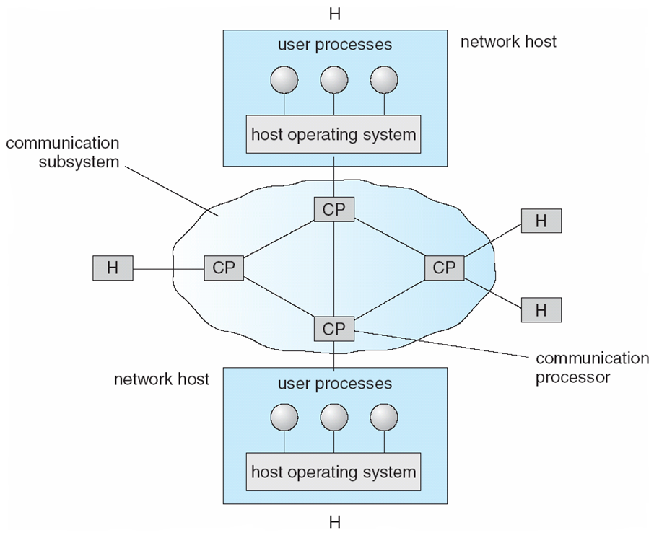
Communication Processors in a Wide-Area Network

Slide 13
Network Topology
Sites in the system can be physically connected in a variety of ways; they are compared with respect to the following criteria:
Installation cost - How expensive is it to link the various sites in the system?
Communication cost - How long does it take to send a message from site A to site B?
Reliability - If a link or a site in the system fails, can the remaining sites still communicate with each other?
The various topologies are depicted as graphs whose nodes correspond to sites
An edge from node A to node B corresponds to a direct connection between the two sites
The following six items depict various network topologies

Slide 14
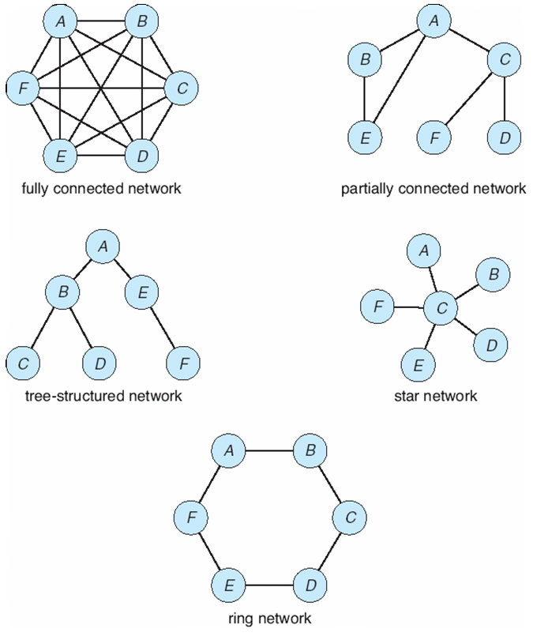
Network Topology

Slide 15
Video Links
https://www.youtube.com/watch?v=MtrcTjJfWSY https://www.youtube.com/watch?v=-OTP2O-UHhI

Slide 16
References
https://www.unf.edu/public/cop4610/ree/Notes/PPT/PPT8E/CH15-OS8e.pdf
https://www.tutorialspoint.com/operating_system/os_security.htm
https://www.coursehero.com/file/19323929/Operating-System-Threats-and-Vulnerabilities/
https://www.cs.uic.edu/~jbell/CourseNotes/OperatingSystems/15_Security.html
https://devqa.io/security-threats-attack-vectors/
https://www.geeksforgeeks.org/system-security/
https://www.javatpoint.com/os-security-management

